Slide 1
CSCIU 210 Computer Organization AKM Jahangir A Majumder, PhD
Fall 2018 - Lecture 25
October 29, 2018
Note: Some slides are adapted from those used by previous instructors and some slides include figures from the textbook.

Slide 2
Review and Learning Outcomes
We will CONTINUE our coverage on MIPS assembly language
We will learn followings today:
Memory organization
Data Transfer
Memory to register
Register to memory
We will learn how to write code in MIPS simulator
We will have Quiz 5 on Friday, November 2, which will cover lecture 20-24
HW 5 is posted on Blackboard, which is due on Wednesday, October 31

Slide 3
Review: In-Class Exercise
Assume a falling edge D Flip-Flop is used, based on clock (C) and input signal (D), draw the D-type flip flop output
Repeat the previous problem assuming a rising edge D Flip-Flop is used.

Slide 4
Review: MIPS Instruction Format
3 Instruction Formats: all 32 bits wide
OP
rs
rt
rd
sa
funct
OP
rs
rt
immediate
OP
jump target

Slide 5
Machine Language: R-Type
Numeric version of instructions is called machine language
Instructions, like registers and words of data, are also 32 bits long
Example: add $t0, $s1, $s2
registers have numbers, $t0=8, $s1=17, $s2=18
Instruction Format: add $t0, $s1, $s2
000000 10001 10010 01000 00000 100000 op rs rt rd shamt funct
Can you guess what the field names stand for?
Notes:
Board work: Binary Numbers

Slide 6
Machine Language: I-Type
Consider the addi instructions,
What would the regularity principle have us do?
New principle: Good design demands a compromise
Introduce a new type of instruction format
I-type for immediates
other format was R-type for register
Example: addi $s1, $s2, 100 8 18 17 100 op rs rt 16 bit number
Where's the compromise?

Slide 7
MIPS Fields
op: Basic operation of the instruction, opcode
rs: The first register source operand
rt: The second register source operand
rd: The register destination operand.
shamt: Shift amount
funct: Function

Slide 8
Assembly Operands: Memory
C variables map onto registers; what about large data structures like arrays?
1 of 5 components of a computer: memory contains such data structures
But MIPS arithmetic instructions only operate on registers, never directly on memory.
Data transfer instructions transfer data between registers and memory:
Memory to register
Register to memory

Slide 9
Anatomy: 5 components of any Computer
Registers are in the datapath of the processor; if operands are in memory, we must transfer them to the processor to operate on them, and then transfer back to memory when done.
Personal Computer
Computer
Processor
Memory
Devices
Control
(“brain”)
Input
Store (to)
Datapath
Registers
Load (from)
Output
These are “data transfer” instructions…
Notes:
That is, any computer, no matter how primitive or advance, can be divided into five parts:
1. The input devices bring the data from the outside world into the computer.
2. These data are kept in the computer’s memory until ...
3. The datapath request and process them.
4. The operation of the datapath is controlled by the computer’s controller.
All the work done by the computer will NOT do us any good unless we can get the data back to the outside world.
5. Getting the data back to the outside world is the job of the output devices.
The most COMMON way to connect these 5 components together is to use a network of busses.

Slide 10
Memory Organization
Viewed as a large, single-dimension array, with an address.
A memory address is an index into the array
"Byte addressing" means that the index points to a byte of memory.
0
8 bits of data
1
8 bits of data
2
8 bits of data
3
8 bits of data
4
8 bits of data
5
8 bits of data
6
8 bits of data
...

Slide 11
Memory Organization
Bytes are nice, but most data items use larger "words"
For MIPS, a word is 32 bits or 4 bytes.
2³² bytes with byte addresses from 0 to 2³²-1
2³⁰ words with byte addresses 0, 4, 8, ... 2³²-4
Words are aligned i.e., what are the least 2 significant bits of a word address?
How long is MIPS’s machine code (how many bits)?
0
32 bits of data
4
32 bits of data
Registers hold 32 bits of data
8
32 bits of data
12
32 bits of data
...

Slide 12
Data Transfer between Processor and Memory
base address + 12
100
base address + 8
10
base address + 4
101
base address + 0
1
Address
Contents
save
Processor
Memory
load

Slide 13
Data Transfer: Memory to Reg (1/4)
To transfer a word of data, we need to specify two things:
Register: specify this by # ($0 - $31) or symbolic name ($s0,…, $t0, …)
Memory address: more difficult
Think of memory as a single one-dimensional array, so we can address it simply by supplying a pointer to a memory address.
Other times, we want to be able to offset from this pointer.
Remember: “Load FROM memory”

Slide 14
Data Transfer: Memory to Reg (2/4)
To specify a memory address to copy from, specify two things:
A register containing a pointer to memory
A numerical offset (in bytes)
The desired memory address is the sum of these two values.
Example: 8($t0)
specifies the memory address pointed to by the value in $t0, plus 8 bytes

Slide 15
Data Transfer: Memory to Reg (3/4)
Load Instruction Syntax:
1 2,3(4)
where
1) operation name
2) register that will receive value
3) numerical offset in bytes
4) register containing pointer to memory
MIPS Instruction Name:
lw (meaning Load Word, so 32 bits or one word are loaded at a time)

Slide 16
Data Transfer: Memory to Reg (4/4)
Data flow
Example: lw $t0,12($s0)
This instruction will take the pointer in $s0, add 12 bytes to it, and then load the value from the memory pointed to by this calculated sum into register $t0
Notes:
$s0 is called the base register
12 is called the offset
offset is generally used in accessing elements of array or structure: base reg points to beginning of array or structure

Slide 17
Data Transfer: Reg to Memory
Also want to store from register into memory
Store instruction syntax is identical to Load’s
MIPS Instruction Name:
sw (meaning Store Word, so 32 bits or one word are loaded at a time)
Example: sw $t0,12($s0)
This instruction will take the pointer in $s0, add 12 bytes to it, and then store the value from register $t0 into that memory address
Remember: “Store INTO memory”
Data flow

Slide 18
Where you can find PCSpim at Computer?
You can find SPIM simulator in the following position:
Start --> EAS Applications --> Course Specific --> PCSpim.
You can also download the latest SPIM simulator in the following web-site:
http://www.cs.wisc.edu/~larus/spim.html

Slide 19
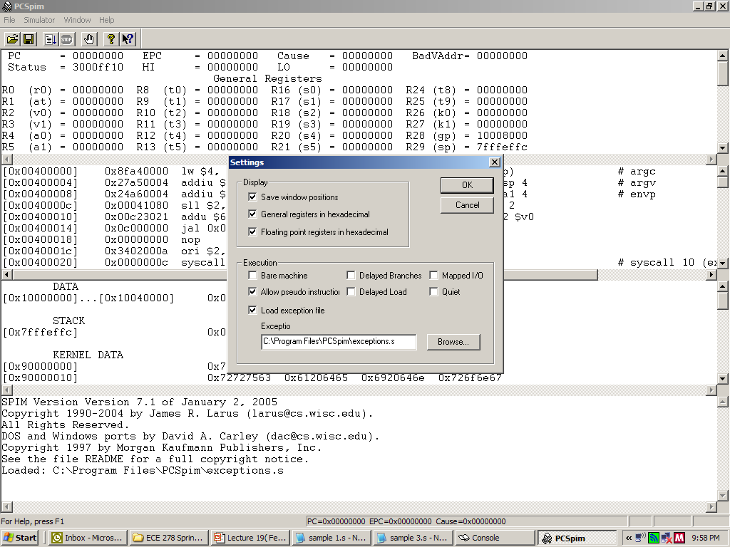
SPIM Simulator Setup
You need to specify the exception handler

Slide 20
System Calls
SPIM provides a small set of operating-system-like services through the system call (syscall) instruction.
To request a service, a program load the system call code into the register $v0 and arguments into registers $a0-$a3.

Slide 21
Partial SPIM System Service List (I)
print_int $a0=integer
print_float $f12=float
print_double $f12=double
print_string $a0=string
read_int put integer in $v0
read_float put float number in $fo
read_double put double in $fo
read_string $a0=buffer, $a1=length
sbrk address in $vo
exit

Slide 22
MIPS Registers
USE Number Name
The constant 0 $0 $zero
Reserved for Assembler $1 $at
Return Values $2-$3 $v0-$v1
Arguments $4-$7 $a0-$a3
Temporary $8-$15 $t0-$t7
Saved Temporaries $16-$23 $s0-$s7
Temporary $24-$25 $t8-$t9
Used by Kernel $26-27 $k0-$k1
Global Pointer $28 $gp
Stack Pointer $29 $sp
Frame Pointer $30 $fp
Return Address $31 $ra

Slide 23
Pseudoinstruction
The following two instructions are not real MIPS instruction. They can be implemented with real MIPS instruction though. Therefore, they are called “pseudoinstructions.” They are created for the convenience of programmers.
li $reg, imm (load immediate)
- $reg=imm
la $reg, address (load address)
- $reg=address
To use pseudoinstructions, you need to specify that pseudoinstrcutions is allowed in the setting of SPIM simulator.

Slide 24
Assembler Directives
Assembler directives begin with a period.
Assembler directives tell the assembler how to translate a program but do not produce machine code for itself.
Example:
.globl sym: declare that label sym is global and can be referred from other files.
.text: subsequent items are put in the user segment. In SPIM, these items may only be instructions or words.
.data: declare that subsequent items are stored in the data segment.
.asciiz str: store the string str in memory and null-terminated

Slide 25
The First Program: Hello World
.text
.globl main
main:
li $v0, 4
la $a0, str
syscall # print string
li $v0, 10
syscall # exit (you must use syscall #10 to exit)
.data
str: .asciiz "Hello World!!!"

Slide 26
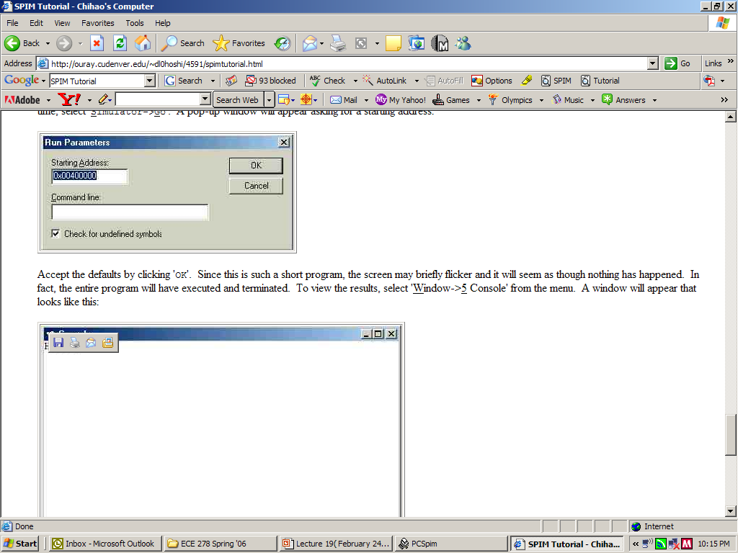
Execute the program
Starting address is 0x00400000

Slide 27
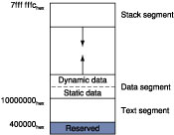
Layout of MIPS Computer Memory

Slide 28
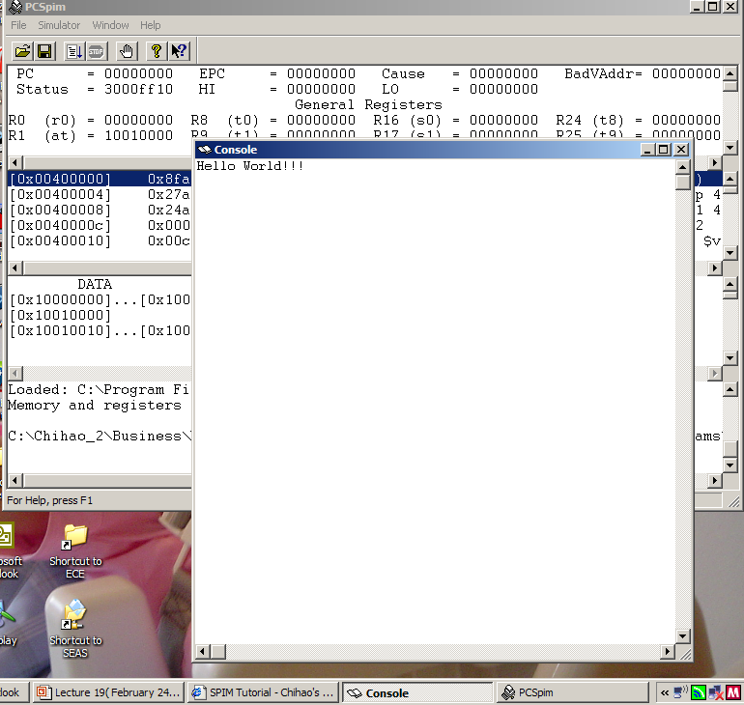
Result of Example Program 1

Slide 29
The Second Program: Addition
.data # data
val1: .asciiz "Enter 1st integer: "
val2: .asciiz "Enter 2nd integer: "
str: .asciiz "The result = “
.text # INSTRUCTIONS
.globl main
main: li $2, 4 # print string
la $4, val1
syscall
li $2, 5 # read 1st in -- result in r2
syscall
move $16, $2 # save 1st integer
li $2, 4 # print string
la $4, val2
syscall
li $2, 5 # read 2nd int -- result in r2
syscall
add $16, $16, $2 # sum both integers
li $2, 4 # print string
la $4, str
syscall
li $2, 1 # print int
move $4, $16
syscall
li $2, 10 # exit program
syscall

Slide 30
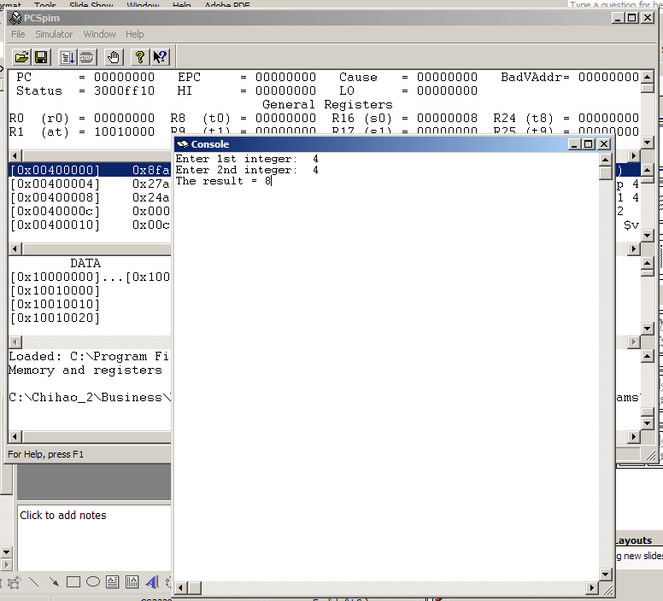
Result of Example Program 2

Slide 31
The Third Program: Taking Text Input
.data # data
prompt: .asciiz "Please enter your name (last, first): "
yname: .asciiz "xxxxxxxxxxxxxxxxxxxxxxxxxxx”
.text # INSTRUCTIONS
.globl main
main: li $2, 4 # print prompt
la $4, prompt
syscall
li $2, 8 # read string
li $5, 20 # length of string = 20
la $4, yname
syscall
li $2, 4 # print result
la $4, yname
syscall
li $2, 10 # exit program
syscall

Slide 32
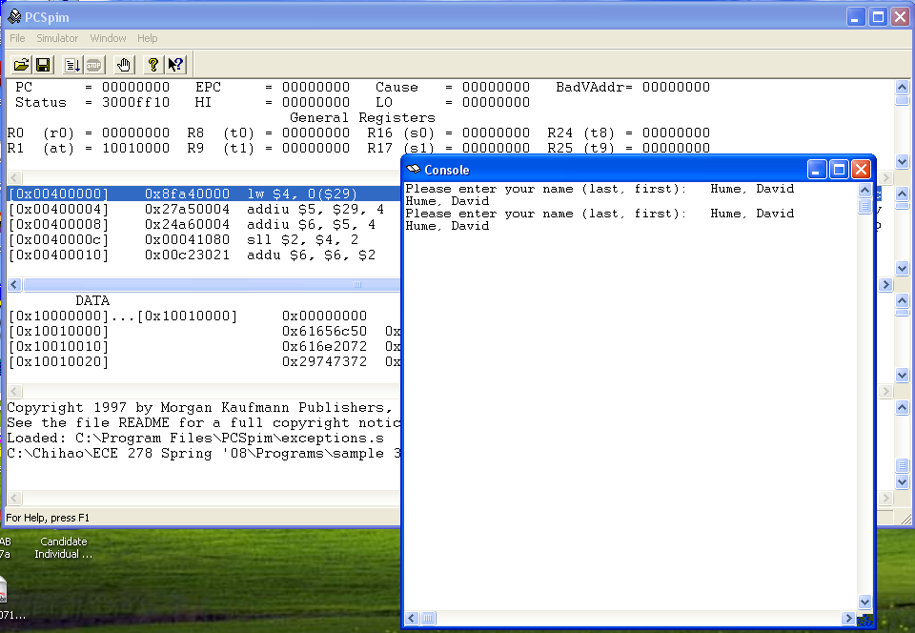
Result of Example Program 3

Slide 33
Exercise
Write a program implementing the following functions.
Ask the user to enter a number with the following prompt
"Please input an integer:”
Add the number by one
Print out the result after the following message
"Next integer is: "

Slide 34
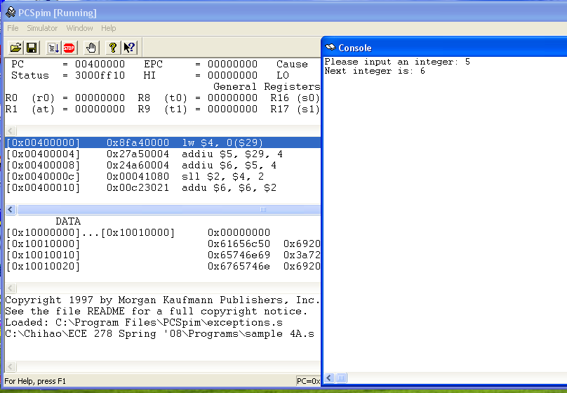
Result of Program Exercise

